Slide 1
Voice Control Home Automation System
A voice controlled sensor that allows
us to control household electrical
Appliances like light, door ,fan, AC etc.
An Internship Report Submitted for Fulfillment of the Samsung Innovation Campaign
Submitted By
Kritika(MCA) ,Hrithik Sharma(MCA), Palak Singh(MCA), Neha Anthony(MCA), Abhishek Kumar Rai(Btech EE)

Slide 2
INTRODUCTION
Voice Controlled Wireless Home Automation Based on internet/ Bluetooth/ wi-fi is a project that is integrated system with mobile phone (application) to give the facility to the elderly and the disable people, so that they can easily control home utilities fully Based on their phone through voice command.
The device is built in such a way that it will be easy to carry, install, configure, run and maintain for the non-technical person. Home automation involves introducing to connect the certain electrical devices that are used in a home.

Slide 3
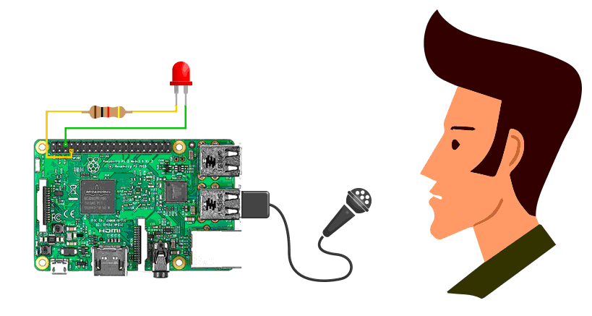
PROJECT OVERVIEW
The Voice Control Home Automation System project uses a combination of hardware and software components to automate the process of Household electricity Appliances . Here's an overview of the key components:
Raspberry Pi 3 with Noobs / Raspbian Os.
A USB webcam with microphone / USB microphone
Windows / linux pc to access Raspberry pi

Slide 4
Aims and Objectives
some of the major aims and objectives of our project.
• This project is designed to use the voice recognition technology to control home utilities i.e. light and fan
• Its implementation especially focuses on the needs of disabled people.
• Google voice recognition facility will be utilised to input voice.
• Android phone will be used for the application software which will be connected to the google voice command input.
• Application software will be responsible for converting the voice command into the text formate

Slide 5
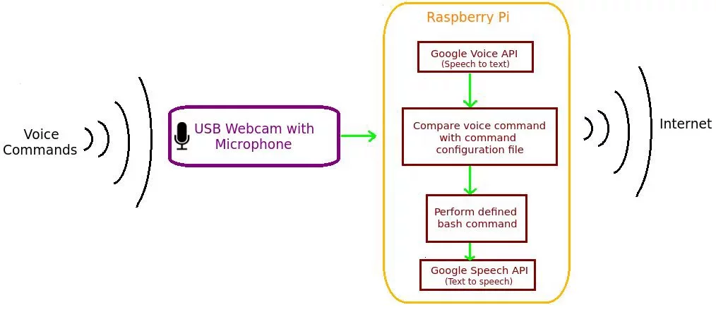
How it Works

Slide 6
Setup for Raspberry Pi
Step 1: First, we have to check whether your microphone or webcam is detected by the Raspberry Pi and the microphone volumes are high. First step is to check your webcam or microphone is listed using the command “lsusb“.
Step2: Setting Microphone Volume High
Step 3: Setting Up Gpio Pins:
To access GPIO Pins you must need to install Wiring Pi on your Raspberry Pi
Step 4: Writing Script
Step 5: Installing the Voice Recognition Software for Raspberry Pi

Slide 7
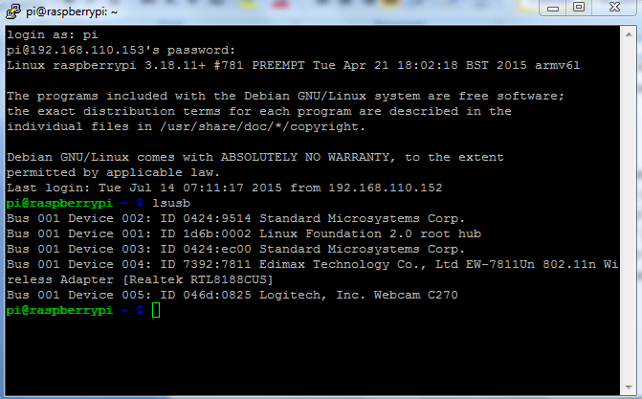
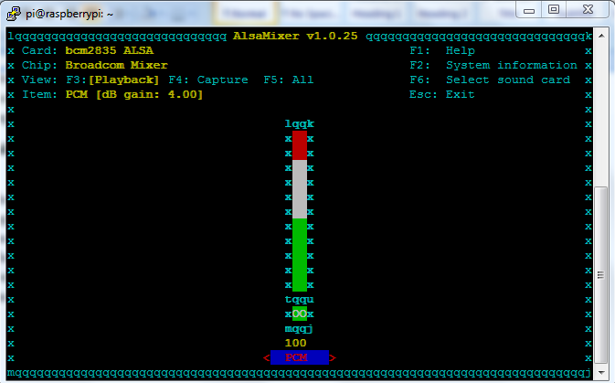
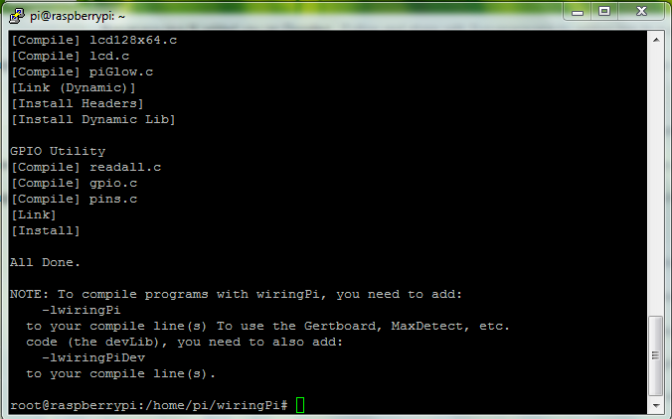
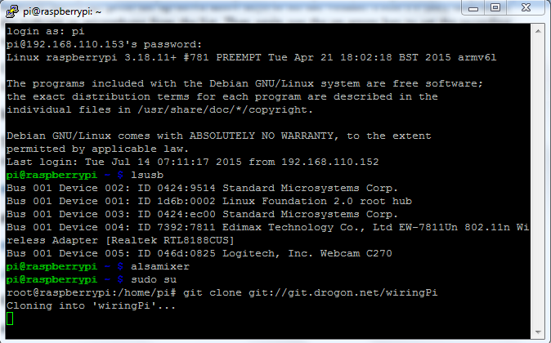
Screenshots for Setups
Setting Up Mic
to Detect Voice
Setting Up
Gpio Pins

Slide 8
Challenges in the home
automation
One of the major challenges that have been faced by the home automation is its cost. Although home automation gives the best ultimate user experience, sometimes affordability factor come up in the middle.
Second major is the cost that is involved in the development process of the system
Lack of required standards is also being one of the challenges that come on the way.

Slide 9
Steps to clone or download the project repository
To clone or download the project repository, these steps were followed:
Open the project's GitHub repository in your web browser.
Click on the green "Code" button.
If Git is already installed on computer, click on "Open with GitHub Desktop" or "Download ZIP". If not, click on "Download ZIP".
If you clicked on "Open with GitHub Desktop", choose a directory to clone the repository to and click "Clone".
If you clicked on "Download ZIP", extract the contents of the ZIP file to a directory of your choice.

Slide 10
THANKYOU

